Slide 1
Biogeochemical Modeling of CH₄ & CO₂ in Arctic Soil Microcosms
Guoping Tang
Environmental Sciences Division
Oak Ridge National Laboratory
April 18, 2016
EGU General Assembly

Slide 2
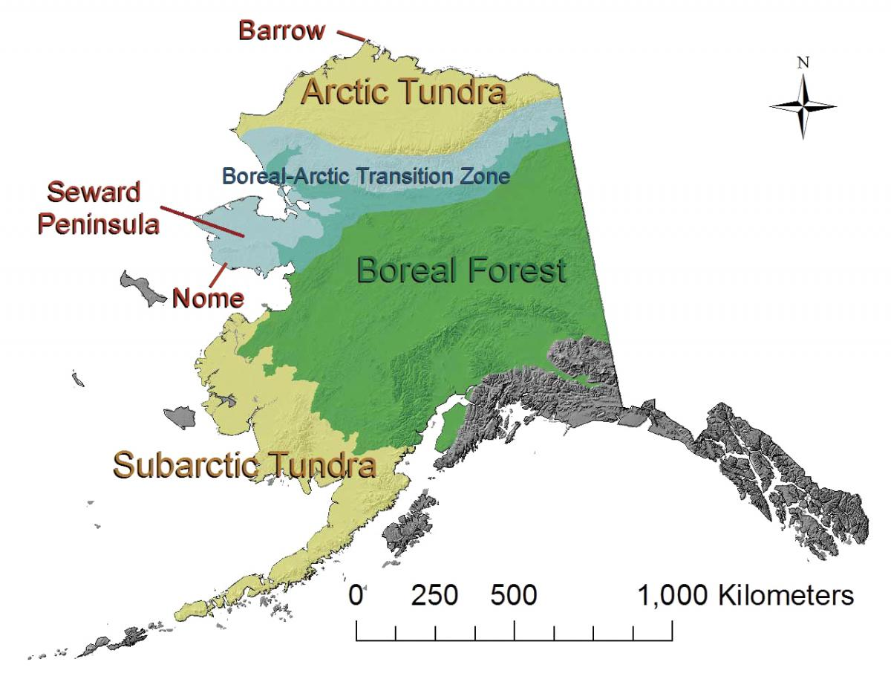
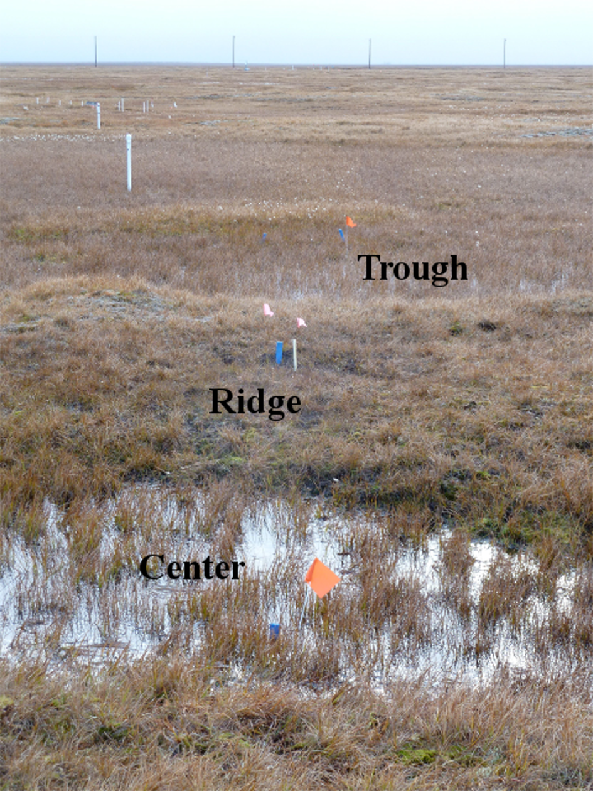
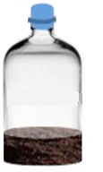
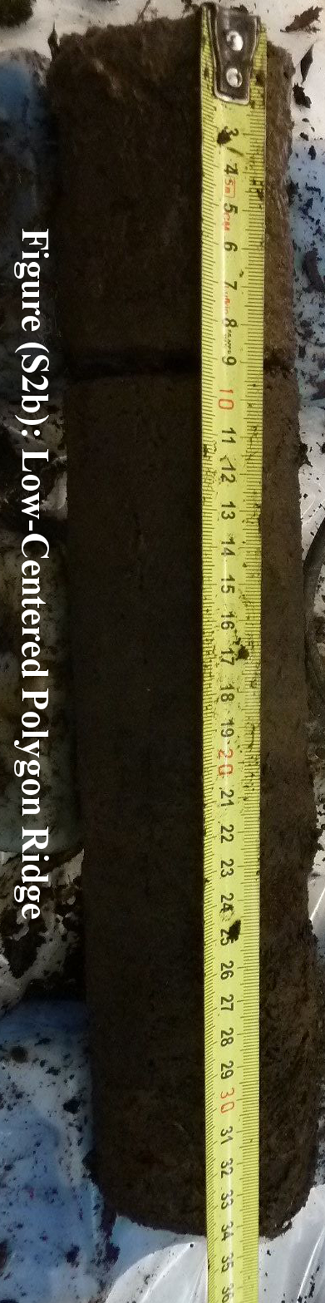
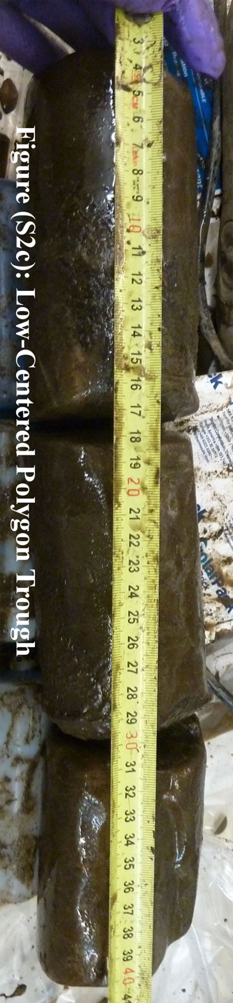
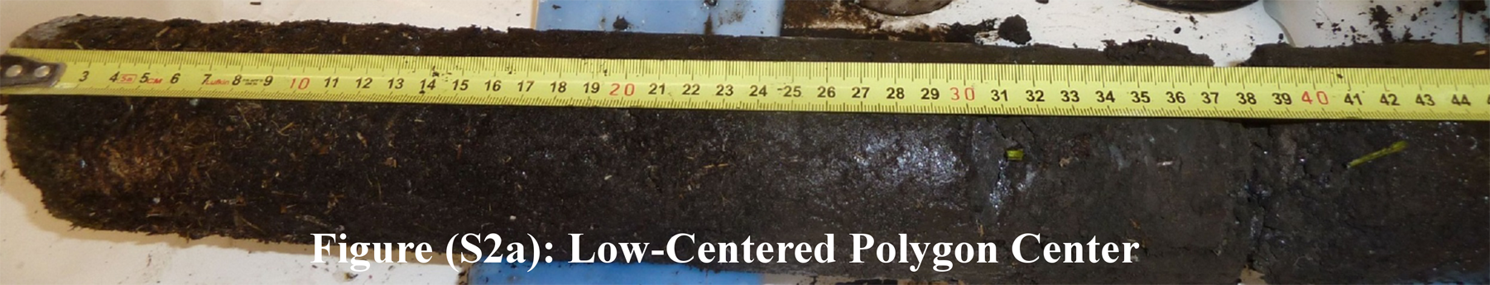
Incubation Tests
Low center polygon
15 or 20 g soil
Organic
pH: 5~5.2
60 ml bottle
~50 cm
N₂
Mineral
pH: 4.5~5
-2, 4, 8 °C
Headspace CO₂, CH₄
Soil pH, Fe(II), organic acids
Trough
Ridge
Center
Roy Chowdhury et al. 2015, Herndon et al. 2015
Notes:
NGEE-Arctic.
US DOE
Mission
Barrow Alaska.
low center polygon.
trough, ridge, and center.
organic and mineral layer.

Slide 3
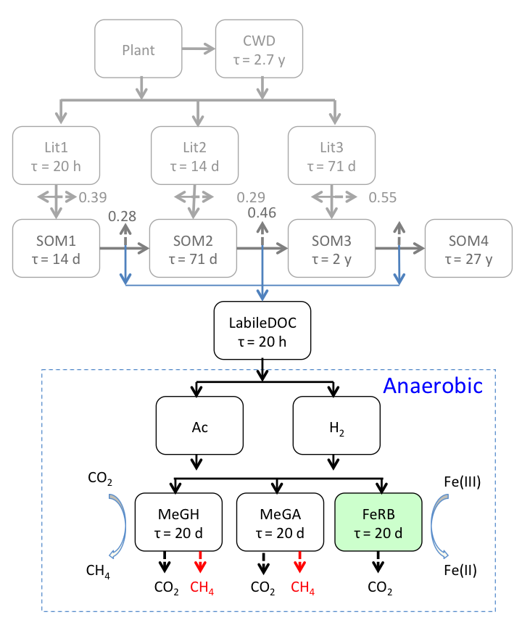
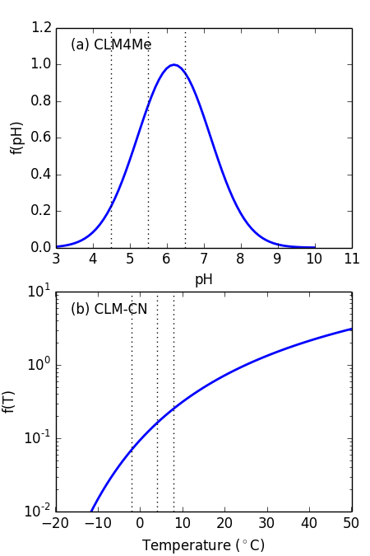
Model Setup
CLM-CN
Humic Ion-Binding Model V (Tipping 1994)
PHREEQC (Parkhurst and Appello 2013)

Slide 4
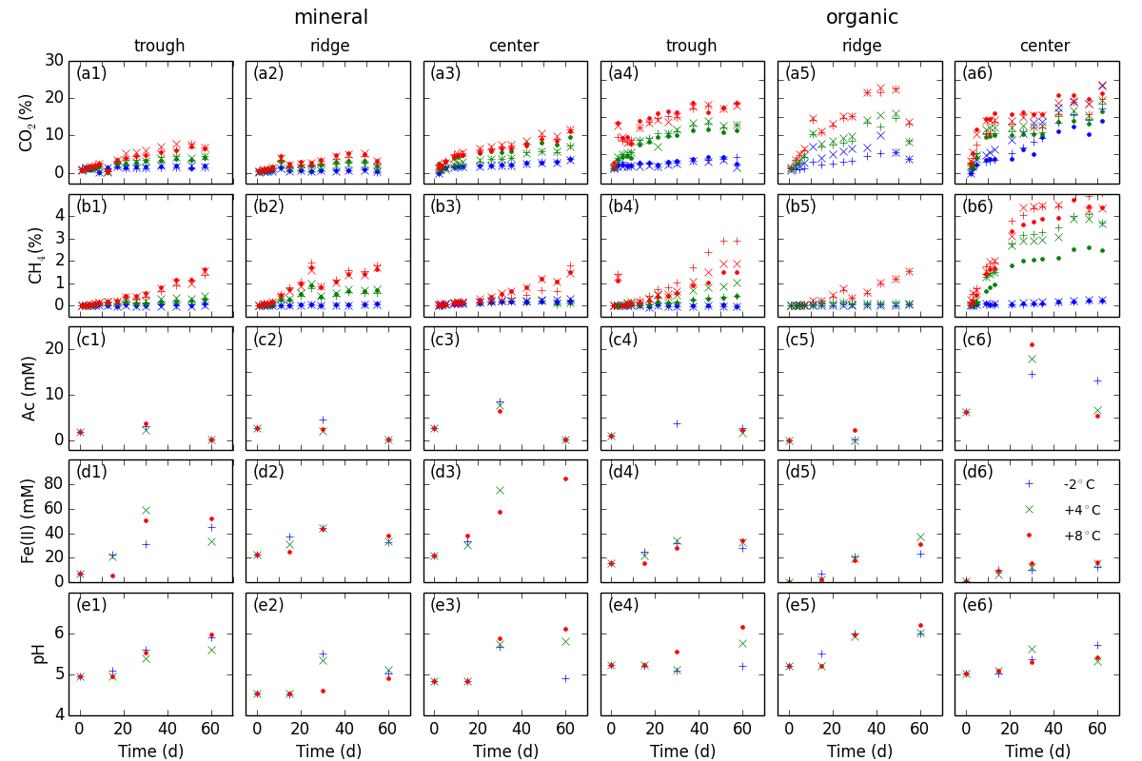
Observations
Roy Chowdhury et al. 2015, Herndon et al. 2015
Notes:
Columns
Rows
Color/temperature
Headspace, CO2, convex
Headspace, CH4, concave
Organic acids
Fe(II)
pH
Now we would like to use these observation to develop a model.

Slide 5
Observations
Roy Chowdhury et al. 2015, Herndon et al. 2015
Notes:
Columns
Rows
Color/temperature
Headspace, CO2, convex
Headspace, CH4, concave
Organic acids
Fe(II)
pH
Now we would like to use these observation to develop a model.

Slide 6
Observations
Roy Chowdhury et al. 2015, Herndon et al. 2015
Notes:
Columns
Rows
Color/temperature
Headspace, CO2, convex
Headspace, CH4, concave
Organic acids
Fe(II)
pH
Now we would like to use these observation to develop a model.

Slide 7
Observations
Roy Chowdhury et al. 2015, Herndon et al. 2015
Notes:
Columns
Rows
Color/temperature
Headspace, CO2, convex
Headspace, CH4, concave
Organic acids
Fe(II)
pH
Now we would like to use these observation to develop a model.

Slide 8
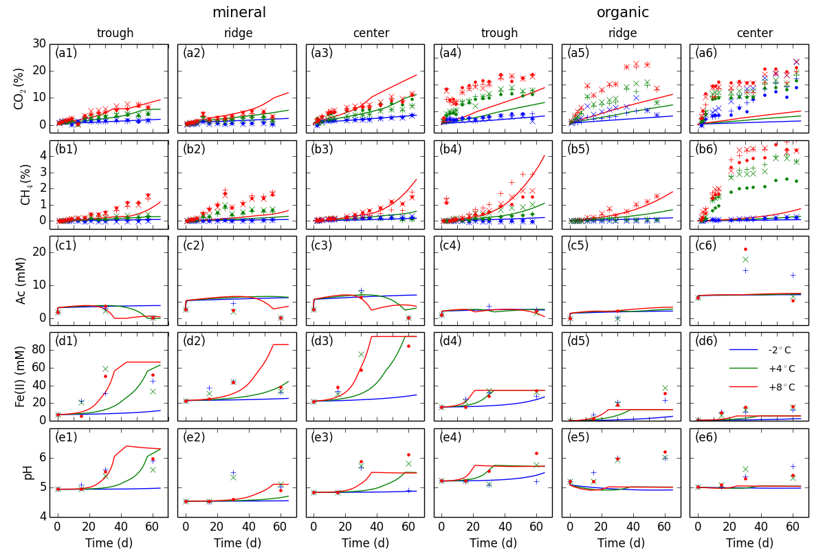
Predictions vs. Observations
LabileDOC = 0.001, SOM1 = 0.01, SOM2 = 0.02, Biomass = 10⁻⁶ TOTC
Fe(III) = 0.005 Soil dry weight, indirect respiration fraction = 0.4

Slide 9
Predictions vs. Observations
LabileDOC = 0.001, SOM1 = 0.01, SOM2 = 0.02, Biomass = 10⁻⁶ TOTC
Fe(III) = 0.005 Soil dry weight, indirect respiration fraction = 0.4

Slide 10
Predictions vs. Observations
LabileDOC = 0.001, SOM1 = 0.01, SOM2 = 0.02, Biomass = 10⁻⁶ TOTC
Fe(III) = 0.005 Soil dry weight, indirect respiration fraction = 0.4

Slide 11
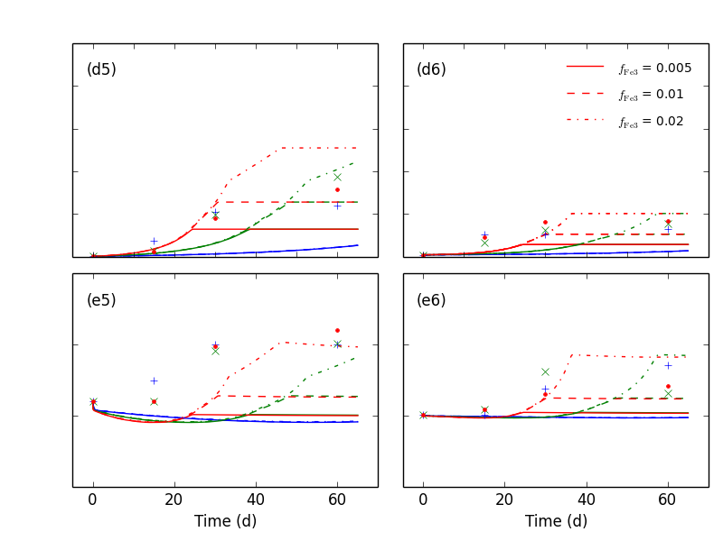
Predictions vs. Observations
LabileDOC = 0.001, SOM1 = 0.01, SOM2 = 0.02, Biomass = 10⁻⁶ TOTC
Fe(III) = 0.005 Soil dry weight, indirect respiration fraction = 0.4

Slide 12
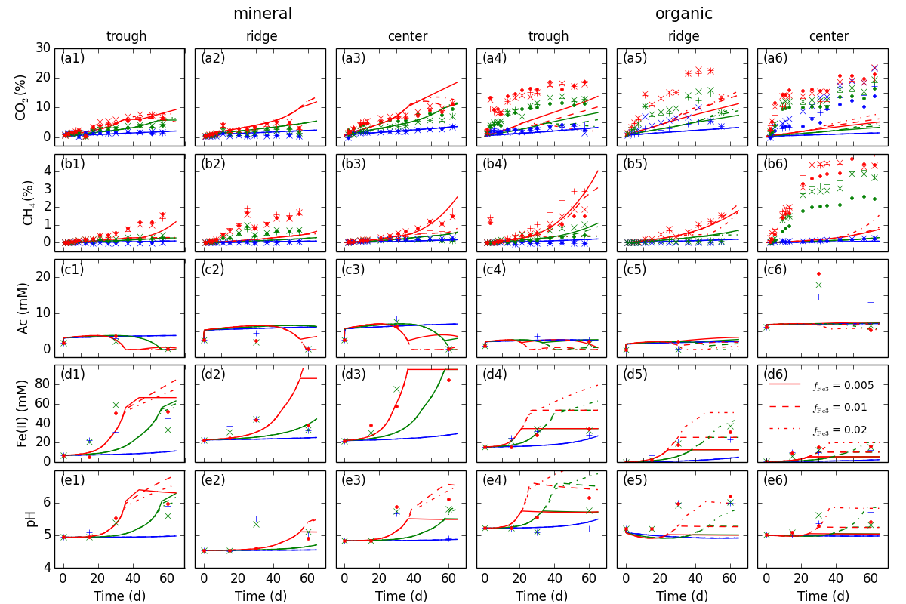
Predictions vs. Observations
Notes:
Fe(III) reduction is generally reported to inhibit methanogenesis due to substrate competition.
Which is the case In the mineral soils where organic acid limits methanogenesis
For the ridge and center organic soils, Fe reduction actually increase methanogenesis because Fe reduction increase the pH, which is favorable for methanogens while the organic acids are not limiting.
Therefore, Fe reduction can inhibit methanogenesis by substrate competition, while promote methanogenesis by raising pH.
Fe reduction increase CO2 concentration in organic ridge, and center soils, and mienral ridge soils, it decrease headspace CO2 concentrations in the rest at the later times.
This is because of increased solubility of CO2 at increased pH.

Slide 13
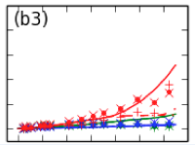
Predictions vs. Observations
Notes:
Fe(III) reduction is generally reported to inhibit methanogenesis due to substrate competition.
Which is the case In the mineral soils where organic acid limits methanogenesis
For the ridge and center organic soils, Fe reduction actually increase methanogenesis because Fe reduction increase the pH, which is favorable for methanogens while the organic acids are not limiting.
Therefore, Fe reduction can inhibit methanogenesis by substrate competition, while promote methanogenesis by raising pH.
Fe reduction increase CO2 concentration in organic ridge, and center soils, and mienral ridge soils, it decrease headspace CO2 concentrations in the rest at the later times.
This is because of increased solubility of CO2 at increased pH.

Slide 14
Predictions vs. Observations
LabileDOC = 0.001, SOM1 = 0.01, SOM2 = 0.02, Biomass = 10⁻⁶ TOTC
Fe(III) = 0.005 Soil dry weight, indirect respiration fraction = 0.4

Slide 15
Predictions vs. Observations
Notes:
Fe(III) reduction is generally reported to inhibit methanogenesis due to substrate competition.
Which is the case In the mineral soils where organic acid limits methanogenesis
For the ridge and center organic soils, Fe reduction actually increase methanogenesis because Fe reduction increase the pH, which is favorable for methanogens while the organic acids are not limiting.
Therefore, Fe reduction can inhibit methanogenesis by substrate competition, while promote methanogenesis by raising pH.
Fe reduction increase CO2 concentration in organic ridge, and center soils, and mienral ridge soils, it decrease headspace CO2 concentrations in the rest at the later times.
This is because of increased solubility of CO2 at increased pH.

Slide 16
Modeling results (2, Fe³⁺ sensitivity)
Notes:
Fe(III) reduction is generally reported to inhibit methanogenesis due to substrate competition.
Which is the case In the mineral soils where organic acid limits methanogenesis
For the ridge and center organic soils, Fe reduction actually increase methanogenesis because Fe reduction increase the pH, which is favorable for methanogens while the organic acids are not limiting.
Therefore, Fe reduction can inhibit methanogenesis by substrate competition, while promote methanogenesis by raising pH.
Fe reduction increase CO2 concentration in organic ridge, and center soils, and mienral ridge soils, it decrease headspace CO2 concentrations in the rest at the later times.
This is because of increased solubility of CO2 at increased pH.

Slide 17
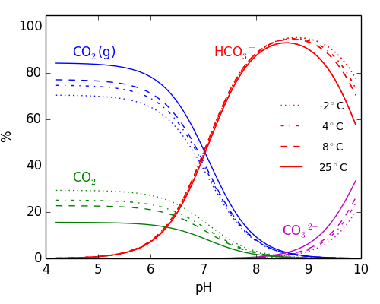
Modeling Results (3, CO₂ partition)
Notes:
Here we conduct calculations with our typical microcosms to see the distribution of CO2.
At low pH, CO2 are mostly in the headspace. The dominance decreases with increasing pH.
The dominance of CO2 gas phase also decreases with decreasing temperature.
In addition, there are substantial amount of CO2 adsorbed in the metal oxides surfaces.
Adding CO2 adsorption introduces an another CO2 into the model microcosms.
Which may contribute to CO2 in the headspace when pH changes, metal oxides reduced and dissolved.
The point is, if we use headspace concentration to estimate respiration, we could underestimate the respiration without adequately accounting for the distribution among adsorbed and dissolved phases.

Slide 18
Take home message
Geochemical models describe pH evolution in soil incubation tests
Fe reduction inhibits methanogenesis through substrate competition and increases methanogenesis rate by increasing pH
CO₂ distribution among aqueous, gas, and adsorbed phase varies with pH, temperature, and pressure, therefore, estimation of CO₂ emission based on headspace concentration needs to adequately account for these conditions

Slide 19
Next Steps
Synthesize additional data for other topographic locations
Add differentiate sugars, alcohols, and organic acids
Test geochemical models in CLM-PFLOTRAN (See poster in Thursday evening)
Input files, scripts and the slides publically available
https://github.com/t6g/egu2016redox

Slide 20


Acknowledgement
Stan Wullschleger
Experiment team
David Graham, Baohua Gu, Jianqiu Zheng, Taniya Roy Chowdhury, Ziming Yang, Melanie Mayes
Modeling team
Peter Thornton, Scott Painter
Notes:
NGEE-Arctic.
US DOE
Mission
Barrow Alaska.
low center polygon.
trough, ridge, and center.
organic and mineral layer.

Slide 21
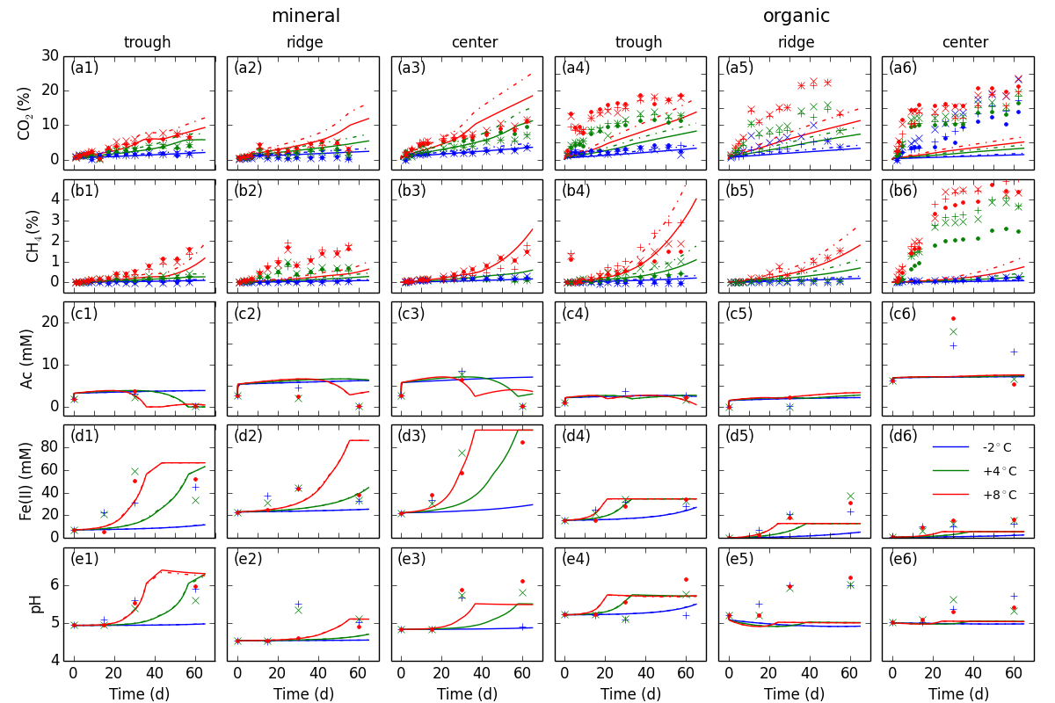
Impact of 20 g vs. 15 g wet soils

Slide 22
Incubation tests
15 or 20 g wet soil
60 ml serum bottle
N₂
-2, 4, 8 °C
Headspace CO₂, CH₄
Soil pH, Fe(II), organic acids
Roy Chowdhury et al. 2015, Herndon et al. 2015
TOTC = total carbon; WEOC = water extractable carbon; OA = organic acids as acetate

Slide 23
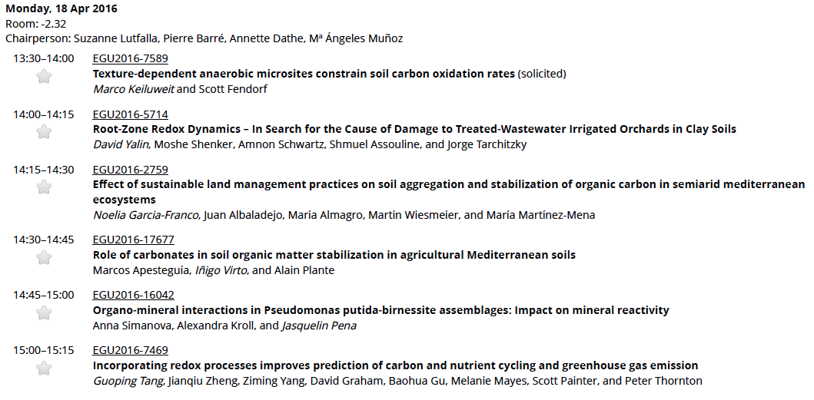
EGU 2016
Session SSS5.2: Monitoring and modelling redox conditions and related reactions in soils
Session SSS5.3 - Monitoring and modelling the influence of mineralogy, aggregation and redox conditions on soil functioning

